Slide 1

Python Bytes - Week 5 Functions + Modules

Slide 2
TABLE OF CONTENTS
Quick Refresher
Default + Keyword Arguments
01
03
02
HW Check + Recap
03
Functions
06

Slide 3

01
Quick Refresher
1. What will be the output?
A.
‘1 2 3’
B.
‘0 1 2 3’
C.
‘0 1 2’
D.
‘1 2’

Slide 4
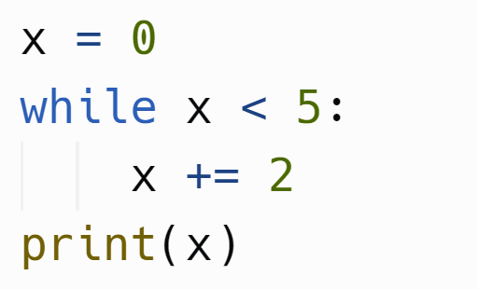
01
Quick Refresher
2. What will be the output?
A.
4
B.
2
C.
0
D.
6

Slide 5
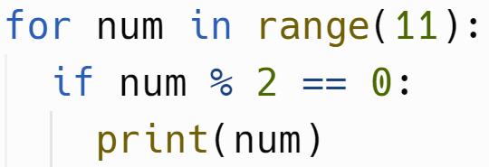
01
Quick Refresher
3. What will be the output?
A.
‘0 2 4 6 8 10’
B.
‘0 1 2 3 4 5 6 7 8 9 10 11’
C.
‘2 4 6 8’
D.
‘2’

Slide 6
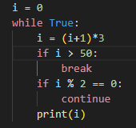
01
Quick Refresher
2. What numbers will be outputted?
A.
3, 12, 39, 120
B.
3, 39
C.
0, 3, 12, 39
D.
0, 3, 39

Slide 7

01
Quick Refresher
2. What will be the output? \n = line break
A.
HH\nii
B.
HiHi\nHiHi
C.
Syntax Error
D.
HiHi

Slide 8

01
Quick Refresher
2. What order of letters will be outputted?
A.
[‘a’, ‘b’], [‘b’, ‘a’]
B.
a, b, a, b, b, a, b, a
C.
a, a, b, b
D.
a, b, b, a

Slide 9

01
Quick Refresher
2. What will be the output? Let , mean new line
A.
3, 4, 4, 5
B.
1, 2, 2, 3
C.
8
D.
3

Slide 10

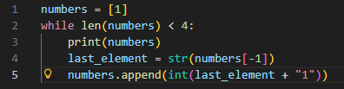



01
Quick Refresher
2. What will be the output? \n stands for line break
A.
B.
C.
D.

Slide 11
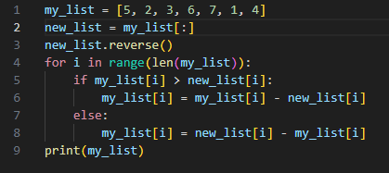
01
Quick Refresher
2. What will be the output?
A.
[0, 0, 0, 0, 0, 0, 0]
B.
[1, 1, 4, 0, 4, 1, 1]
C.
[1, 1, -4, 0, 4, -1, -1]
D.
[5, 5, 5, 5, 5, 5, 5]

Slide 12
HW Check

Slide 13
Linkie

Slide 14
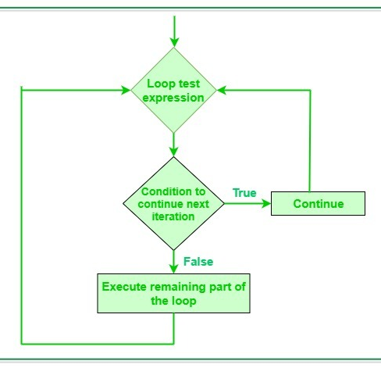
02
Last Week Recap
Compound Operators
  +=
  -=
  *=
  **=
  %=
  /=
  //=

Slide 15
02
Last Week Recap
For Loops: Something that iterates through a block of code or a string certain amount of times. (Also can iterate through a list, but that’s for another day)
While Loops: A loop that iterates through a block of code when the condition is true.
Break and Continue Statements: Breaks stops the loop from working, while continue skips to the next iteration of the loop

Slide 16
02
Last Week Recap
Lists: Collection of items
.append(?)
.insert(#, ?)
.sort()
.reverse()
[#]
[#:#]
[:-1]
len(list)
.remove(?)
NEW: .pop(#)

Slide 17
02
Last Week Recap
if you want to learn more, check the meeting notes; sometimes, some information is added there if you want extra study! (like the sorted() function)
python is really cool and there’s so much stuff it’s impossible to cover in just classes, so feel free to explore and research on your own time!

Slide 18
03
Functions

Slide 19

03
Functions
A function is a reusable block of code that performs a specific task.
It takes some inputs and returns some outputs.
Functions can do a lot, like organizing code.
Basic Syntax:

Slide 20
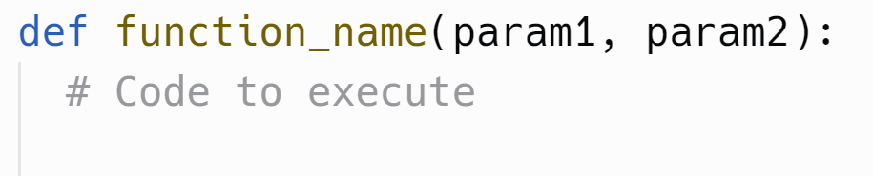
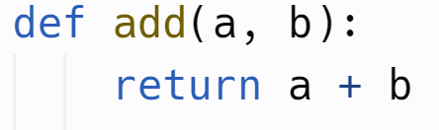
03
Function Parameters & Return
Function Parameters: Variables passed into a function to provide input values. They help functions to process different data and perform tasks based on the input.
Function Return: The output or result produced by a function. They provide data from the function that can be used elsewhere in your code.
note: a lot of the stuff we’ve used are functions! like print(), remove(), input(), etc.

Slide 21
Coding Time!
Open up Vs and let's start coding:
Functions
Lets make a guessing game!

Slide 22
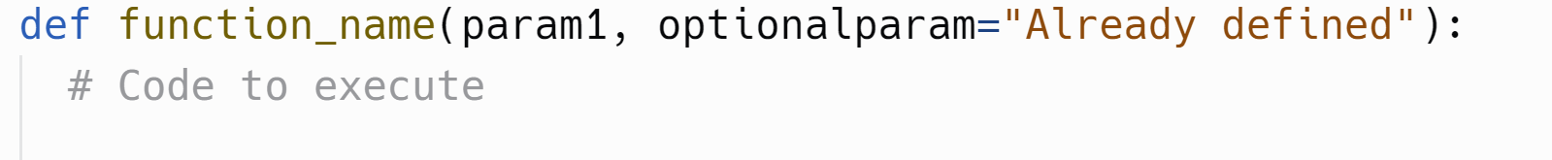
04
Default & Keyword Arguments
Default Arguments: Arguments that assume a default value if no value is provided during the function call, they are optional parameters.
Keyword Arguments: Arguments passed to a function by explicitly specifying the parameter name, allowing you to pass arguments in any order.

Slide 23
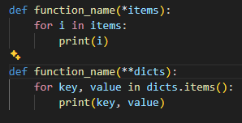
04
Arbitrary (Keyword) Arguments
*args
We can pass as many arguments as we want, they will be stored in the list name. Example: print(*objects)
**kwargs
We will not be learning this now, it allows passing as many keyword arguments as we want. Feel free to research it, though it requires knowledge of dicts.

Slide 24
Thats It!

